Slide 1


Hotel Booking Analysis
CAPSTONE PROJECT
SUBMITTED BY
Vijay Chaudhary
VIJAY CHAUDHARY

Slide 2

Problem Statement :
For this project we will be analyzing hotel booking data .This data set contains booking information for a city hotel and a resort hotel ,and includes information such as when the the booking was made , length of stay ,the number of adults ,children ,and/or babies, and the number of available parking spaces.
Hotel industry is a very volatile industry and the bookings depends on above factors and many more.
The main objective behind this project is to explore and analyze data to discover important fators that govern the bookings and give insights to hotel management which can perform various campaigns to boost the business performance.

Slide 3
Work Flow :
So we will divide our work flow into following three steps:
Data Collection
And
Understanding
Data Cleaning
And
Manipulation
Exploratory
Data
Analysis(EDA)
EDA will be divided into following three steps:
Univariate analysis : Univariate analysis is the simplest of the three analysis where the data you are analyzing is only one variable.
Bivariate analysis : Bivariate analysis is where you are comparing two variables to study their relationships.
Multivariate analysis : Multivariate analysis is similar to bivariate analysis but you are comparing more than two variables.

Slide 4
Data collection and understanding :
After collecting data it’s very important to understand your data . So we had hotel Booking
Analysis which had 119390 rows and 32 columns . So let’s understand this 32 columns.
Data Description :
hotel : Resort Hotel or City Hotel
is_canceled : Value indicating if the booking was canceled (1) or not (0)
lead_time : Number of days that elapsed between the entering date of the booking and
the arrival date
arrival_date_year : Year of arrival date
arrival_date_month : Month of arrival date
arrival_date_week_number : Week number of year for arrival date
arrival_date_day_of_month : Day of arrival date
stays_in_weekend_nights : Number of weekend nights
stays_in_week_nights : Number of week nights
adults : Number of adults
children : Number of children
babies : Number of babies
meal : Type of meal booked
country : Country of origin

Slide 5
Data Collection and Understanding:
market_segment : Market segment designation. (TA/TO) distribution_channel : Booking distribution channel.(T/A/TO) is_repeated_guest : is a repeated guest (1) or not (0) previous_cancellations : Number of previous bookings that were cancelled by the customer prior to the current booking previous_bookings_not_canceled : Number of previous bookings not cancelled by the customer prior to the current booking reserved_room_type : Code of room type reserved. assigned_room_type : Code for the type of room assigned to the booking. booking_changes : Number of changes made to the booking from the moment the booking was entered on the PMS until the moment of check-in or cancellation deposit_type : No Deposit, Non Refund , Refundable. agent : ID of the travel agency that made the booking company : ID of the company/entity that made the booking . days_in_waiting_list : Number of days the booking was in the waiting list before it was confirmed to the customer customer_type : type of customer. Contract,Group,transient,Transient party. adr : Average Daily Rate as defined by dividing the sum of all lodging transactions by the total number of staying nights required_car_parking_spaces : Number of car parking spaces required by the customer total_of_special_requests : Number of special requests made by the customer (e.g. twin bed or high floor) reservation_status : Reservation last status.

Slide 6
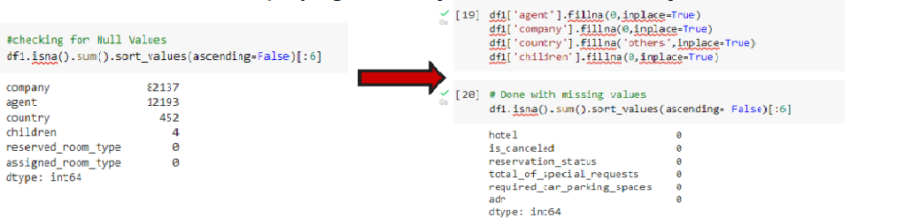
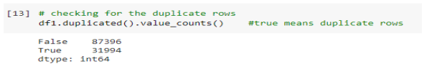
Data Cleaning and Manipulation:
> There were 4 columns company, agent, country and children with missing values.
> Handling Duplicates: Data had 31994 duplicates values. So we dropped it from the data.
> Feature Engineering:
We created 2 new columns 1)‘Total_People’ = from the Children, adults, babies.
2) ‘Total_stay’ = From weekend nights and weekdays night
# Lets add some new coloumn:

Slide 7
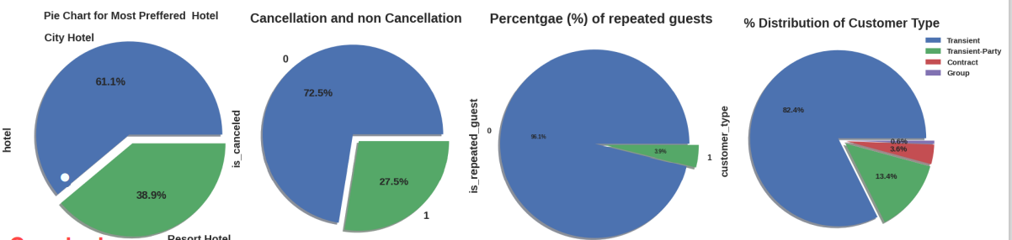
Exploratory Data Analysis (EDA) :
Conclusions:
> City hotels is the most preferred hotel type by the guests. We can say City hotel is the busiest hotel.
> 27.5 % bookings were got cancelled out of all the bookings .
> Only 3.9 % people were revisited the hotels. Rest 96.1 % were new guests. Thus retention rate is low.
> Most of the customers/guests were Transient type(82.4%). And transient party were 13.4% and 0.6 belongs to group. Remaining guests belongs to Contract type.
Contract- when the booking has an allotment or other type of contract associated to it.
Group - when the booking is associated to a group.
Transient- when the booking is not part of a group or contract, and is not associated to other transient booking.
Transient-party- when the booking is transient, but is associated to at least other transient booking

Slide 8
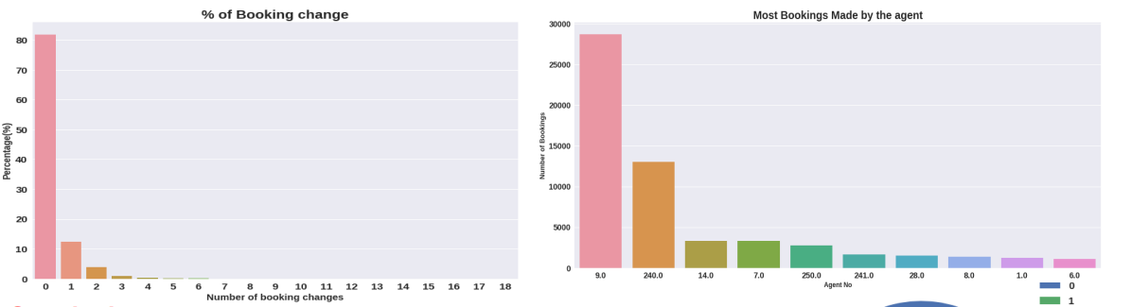
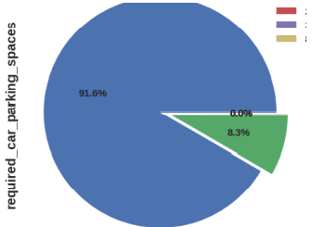
Exploratory Data Analysis (EDA) :
Conclusions:
The percentage of 0 changes made in the booking was more than 82 %. Percentage of Single changes made was about 10%.
Agent Id no -9 made the highest bookings which is more than 28721..
Most of the customers(91.6%) do not require car parking spaces. Only 8.3 % people required only 1 car parking space.

Slide 9
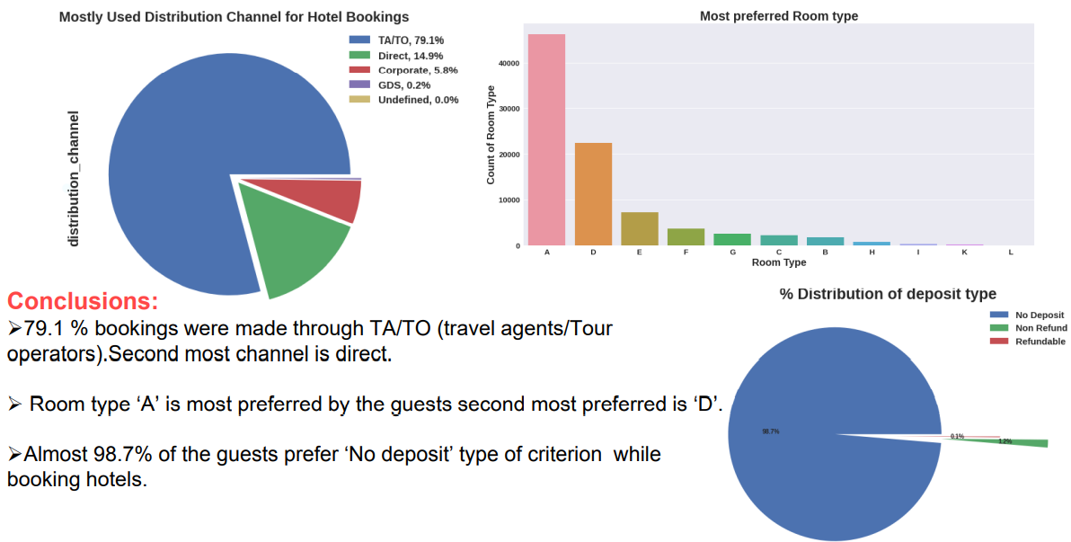
Exploratory Data Analysis (EDA) :

Slide 10
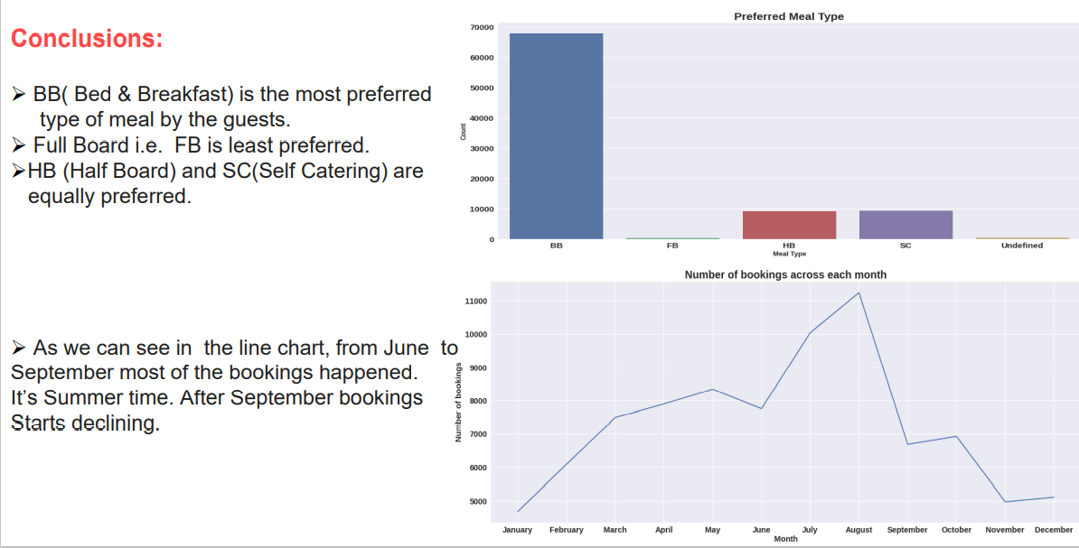
Exploratory Data Analysis (EDA) :

Slide 11
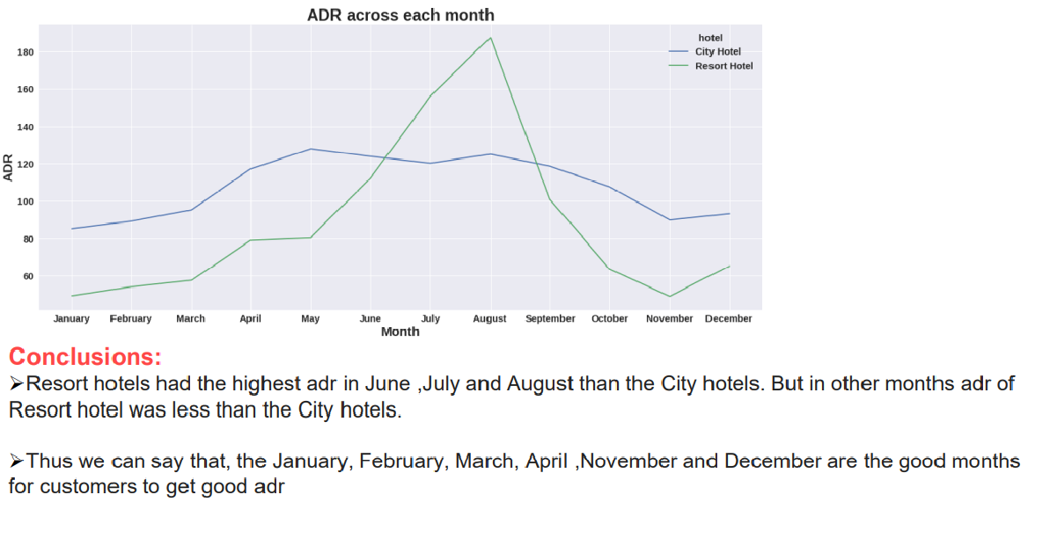
Exploratory Data Analysis (EDA) :

Slide 12
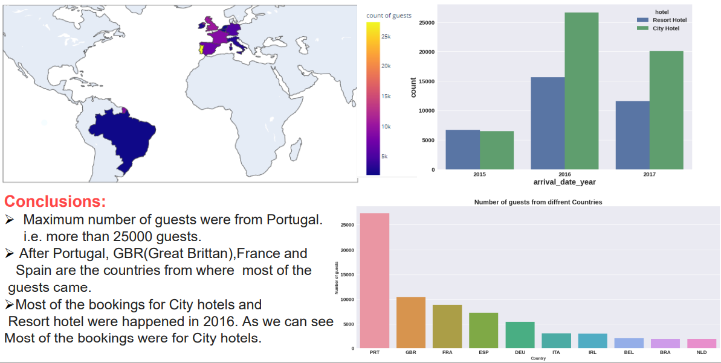
Exploratory Data Analysis (EDA) :

Slide 13
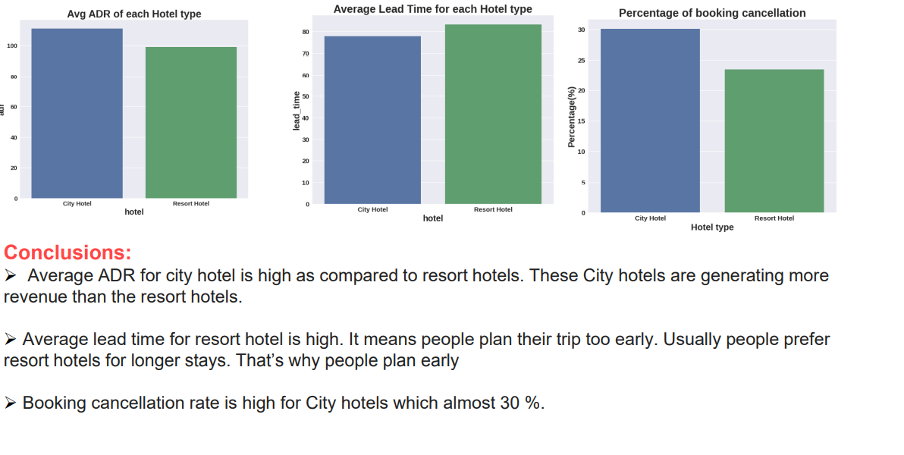
Exploratory Data Analysis (EDA) :

Slide 14
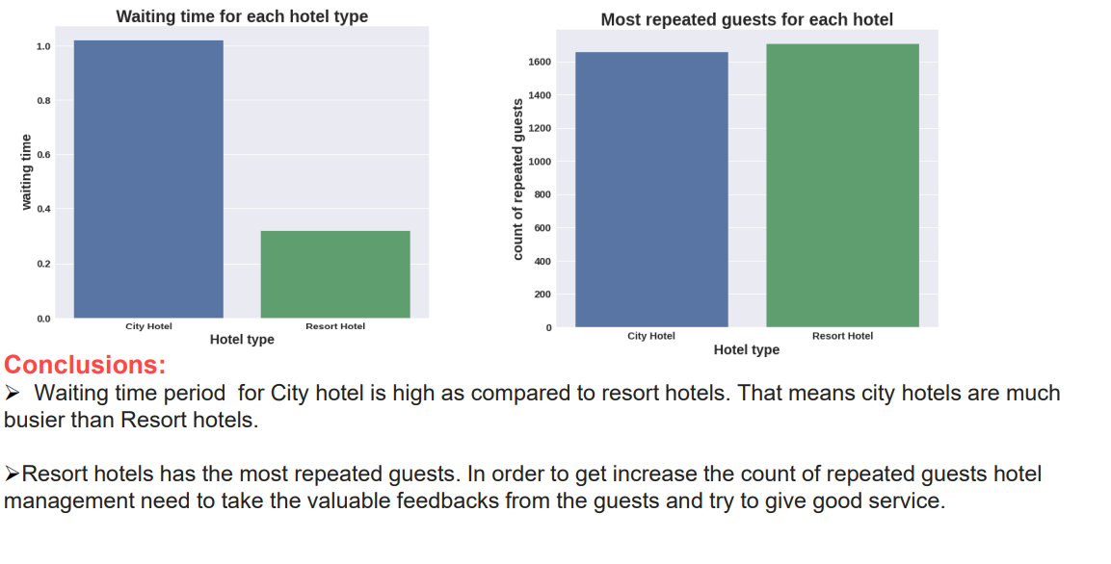
Exploratory Data Analysis (EDA) :

Slide 15
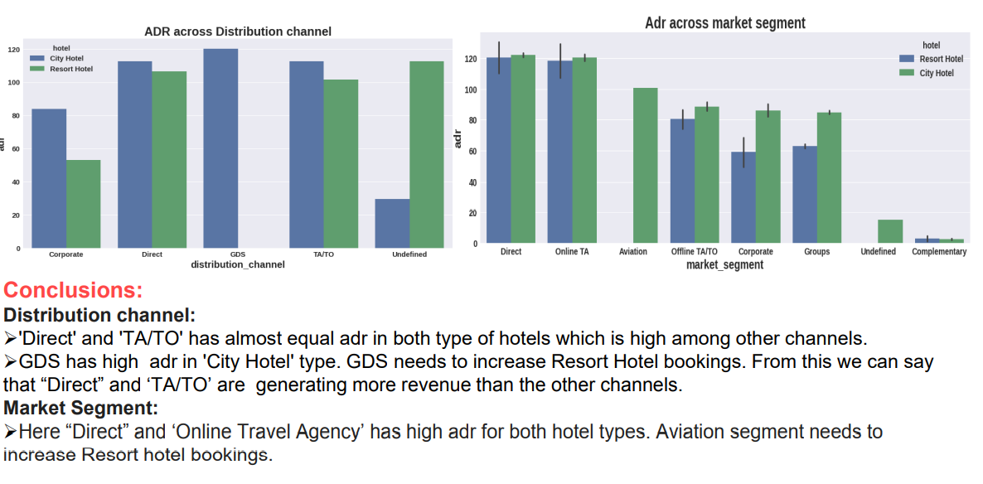
Exploratory Data Analysis (EDA) :

Slide 16
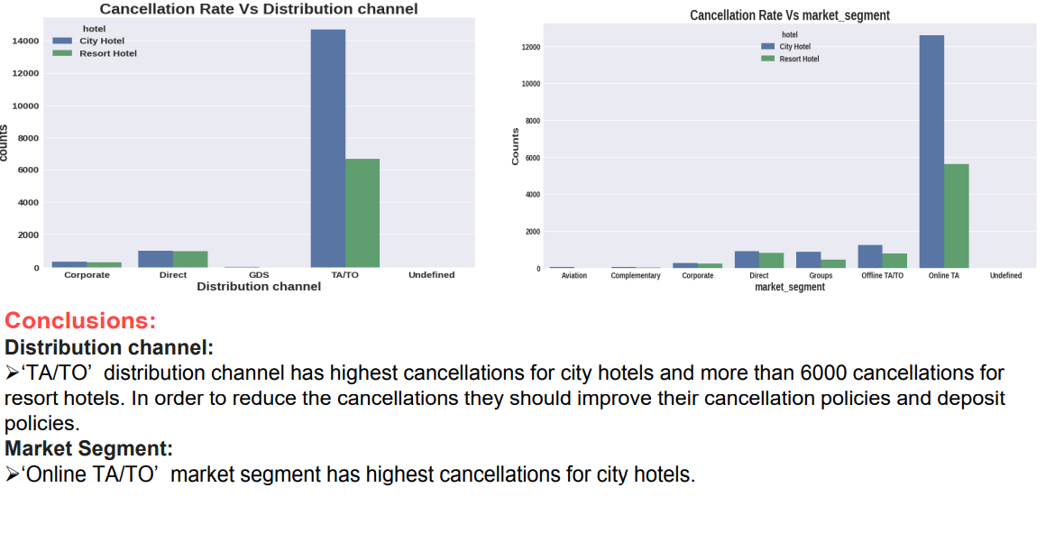
Exploratory Data Analysis (EDA) :

Slide 17
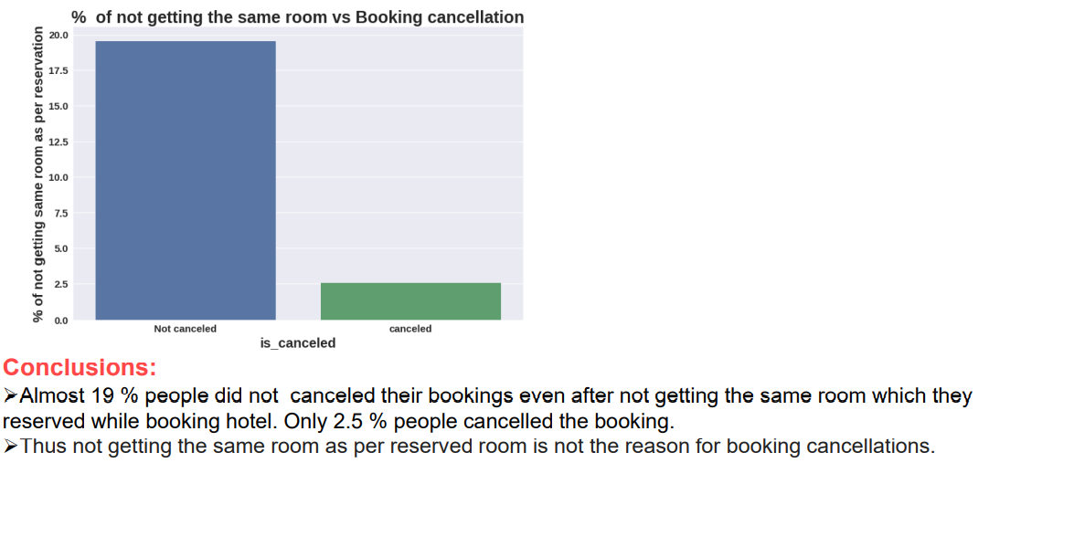
Exploratory Data Analysis (EDA) :

Slide 18
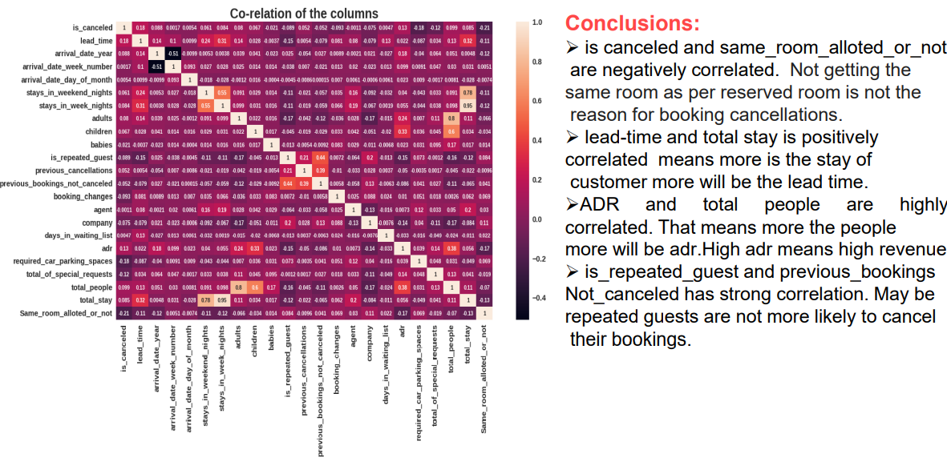
Exploratory Data Analysis (EDA) :

Slide 19
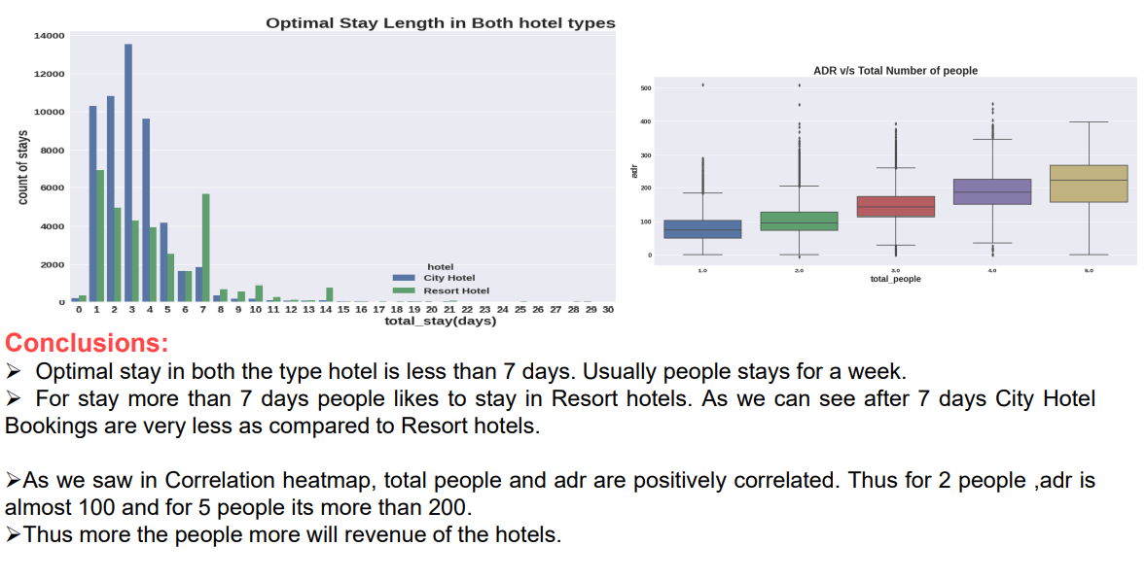
Exploratory Data Analysis (EDA) :

Slide 20


